Slide 1
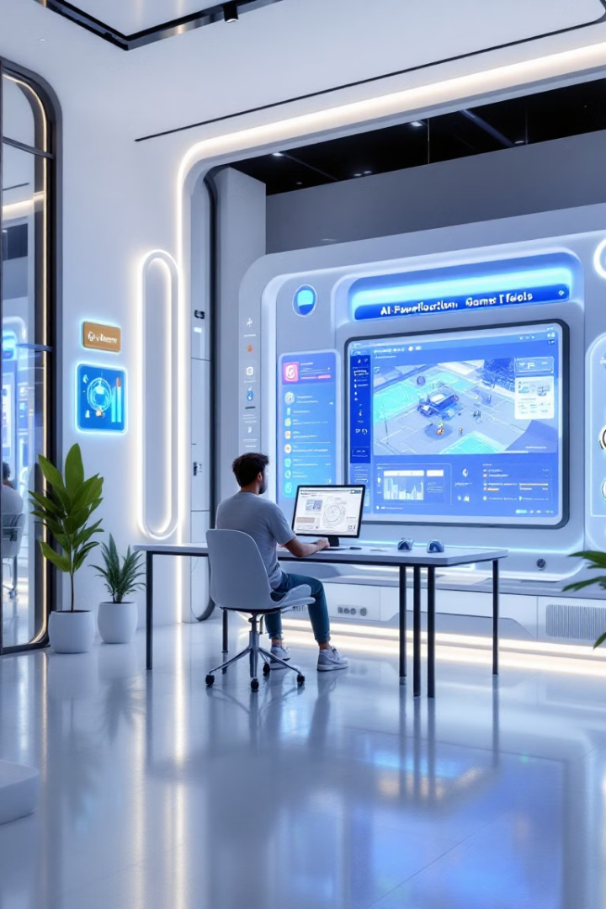
AI-Powered Game Creation Platform
Welcome to the future of game development. Our platform empowers creators of all levels to build amazing games with the assistance of cutting-edge AI technology. Experience a streamlined, intuitive workflow and unleash your imagination like never before.

Slide 2

Project Overview & Objectives
1
Objective 1
2
Objective 2
To democratize game development by providing accessible and powerful tools for individuals and small studios.
To leverage AI to automate repetitive tasks and streamline the game creation process, enabling developers to focus on creativity and innovation.
3
Objective 3
4
Objective 4
To foster a thriving community of game creators, providing resources and tools for collaboration, learning, and sharing.
To contribute to the evolution of game development by pushing the boundaries of what's possible with AI technology.

Slide 3
Problem Statement & Solution
Problem
Solution
Traditional game development often requires extensive technical skills and resources, making it challenging for aspiring game creators to enter the field. The process can be tedious, time-consuming, and expensive.
Our AI-powered platform simplifies the game creation process by automating complex tasks and providing intuitive tools. This empowers individuals and smaller teams to create high-quality games without extensive technical expertise, making game development more accessible and affordable.

Slide 4
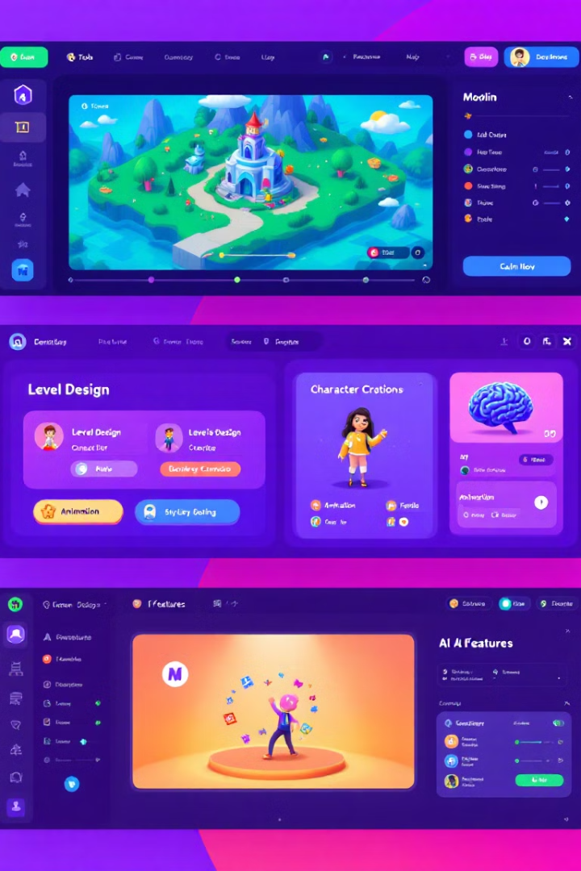
Core Features
AI-Assisted Level Design
AI-Driven Character Creation
Generate complex and engaging levels with the help of our AI, which can create layouts, populate environments, and suggest creative elements.
Create unique and compelling characters using our AI tools, which can design appearances, generate animations, and develop personalities.
AI-Powered Gameplay Mechanics
Community-Driven Assets
Enhance gameplay with AI-powered features such as dynamic difficulty adjustments, adaptive enemy behaviors, and intelligent NPC interactions.
Access a vast library of user-generated assets, including models, textures, sound effects, and music, to enhance your game's production.

Slide 5





Use of Vultr's Services
Cloud Computing
Database Management
Networking & Security
Virtualization
Leverage Vultr's scalable and reliable cloud infrastructure to host our platform and ensure optimal performance for our users.
Benefit from Vultr's secure and reliable network infrastructure to provide a stable and secure environment for our platform.
Employ Vultr's virtualization solutions to create isolated and secure environments for each user, ensuring seamless and reliable performance.
Utilize Vultr's managed database services to store and manage game data, user information, and other critical assets.

Slide 6
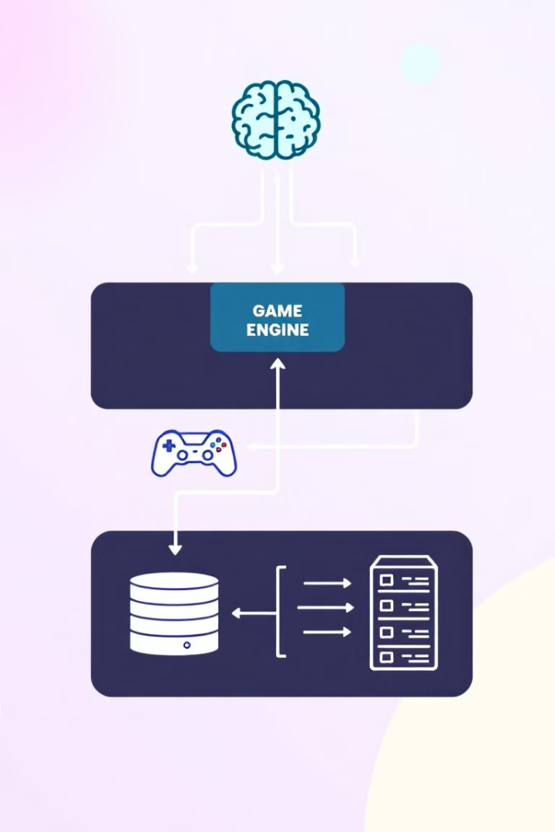




High-Level Architecture
User Interface
Provides a user-friendly interface for game creation, asset management, and community interaction.
AI Engine
Powers AI-assisted features like level design, character creation, and gameplay mechanics.
Game Engine
Runs the game logic, handles physics, and renders graphics.
Database
Stores game data, user information, and assets.

Slide 7

Technical Complexity
AI Algorithm Development
Developing advanced AI algorithms for various game development tasks, including level generation, character design, and gameplay mechanics.
Machine Learning Integration
Integrating machine learning models to analyze user data, improve AI performance, and personalize the user experience.
Game Engine Optimization
Optimizing the game engine to handle AI processing and ensure smooth performance across different platforms and devices.

Slide 8

Scalability & Performance
Scalable Infrastructure
Load Balancing
Leveraging Vultr's cloud infrastructure to accommodate a growing user base and handle increasing demand for AI processing.
Distributing workloads across multiple servers to prevent bottlenecks and maintain performance even under heavy traffic.
1
2
3
Optimized Performance
Implementing caching mechanisms and other performance optimizations to ensure a smooth and responsive user experience.

Slide 9
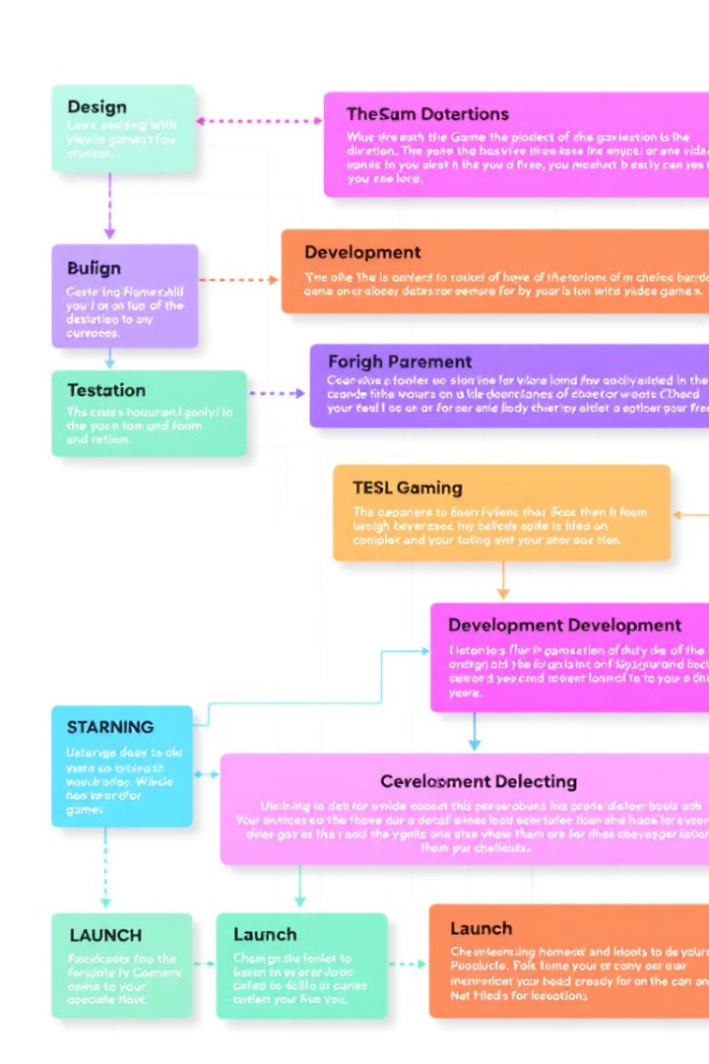
Timeline & Milestones
1
Milestone 1
Develop core platform features, including AI-assisted level design and character creation.
2
Milestone 2
Integrate Vultr's services for cloud infrastructure and database management.
3
Milestone 3
Conduct thorough testing and quality assurance to ensure a seamless and reliable user experience.
4
Milestone 4
Launch the platform to the public, followed by ongoing updates and feature enhancements.

Slide 10
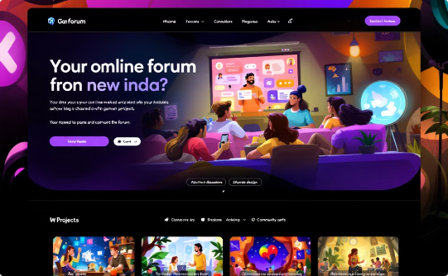


Expected Outcomes & Future Growth
Community Growth
Game Portfolio Expansion
Technological Advancement
Building a thriving community of game developers, fostering collaboration, knowledge sharing, and asset exchange.
Expanding the platform's portfolio of user-created games, attracting a wider audience and generating increased interest in the platform.
Continuously pushing the boundaries of AI technology in game development, introducing new features and functionalities to enhance the user experience.

